Slide 1
Caches
Pavel Kryukov Kirill Korolev
15 February 2019 22 February 2019

Slide 2
Agenda
Memory Wall
Spatial and temporal locality
Hardware implementations
Performance metrics
Software optimizations
Hardware optimizations
Prefetching
Replacement
Write handling
Multi-level cache organization
Modeling in simulator

Slide 3
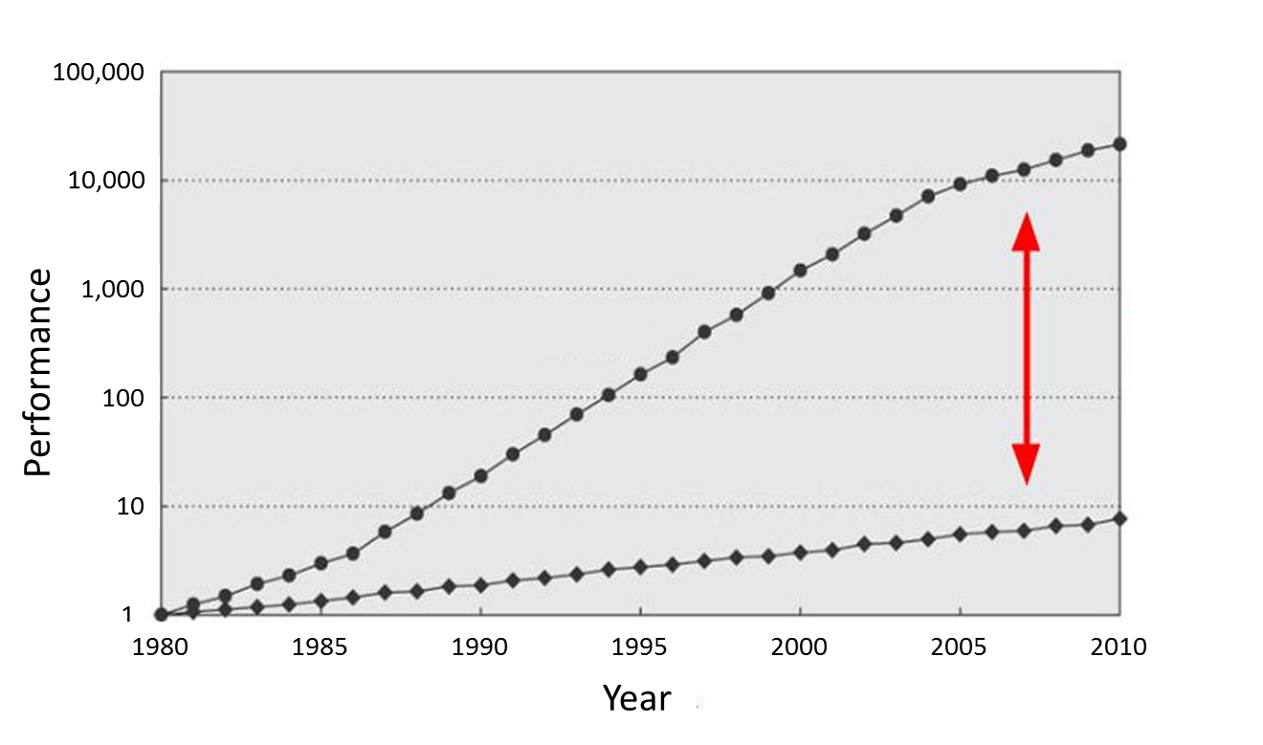
Memory Is Slow
CPU
60% per year
(Doubles every 1.5 year)
Performance gap
9% per year
(Doubles every 10 year)
DRAM

Slide 4
Why is memory slow?
A1: Memory uses DRAM technology, while registers are SRAM
DRAM is slower, but cheaper
This is not the answer: may we use SRAM for memory?
A2: Memory transistors are smaller, therefore they are slower
Again: may we use big transistors for memory?
DRAM cell
SRAM cell

Slide 5
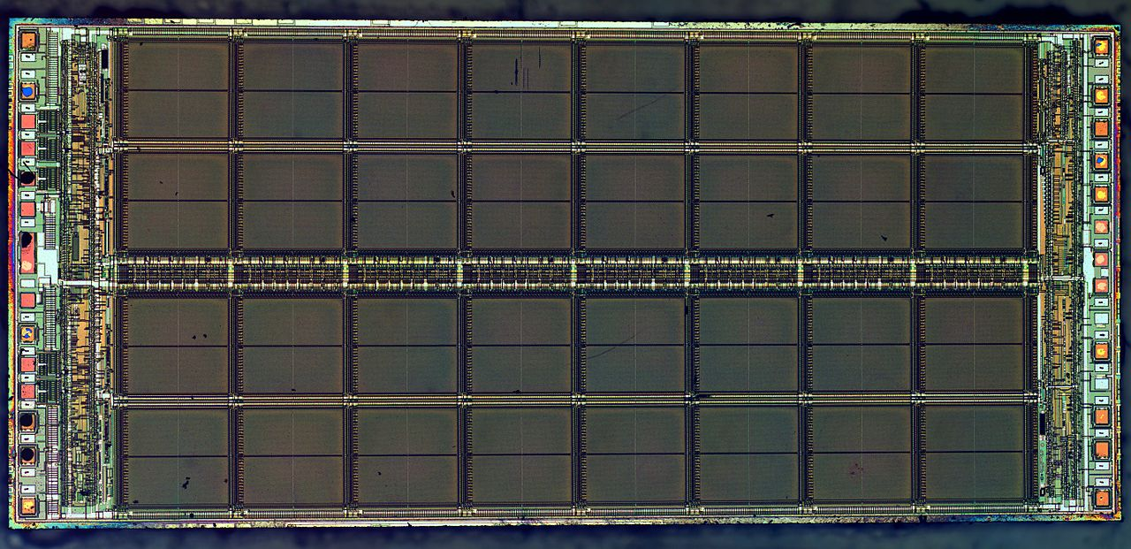
Correct answer is: density/latency balance
Large memory arrays have large area, so wires have to be long
Large memory cannot be fast. Fast memory cannot be large.

Slide 6
Refresher: Pipeline limitations
Max speed of the pipeline is one instruction per clock
It is rare achievable in in-order processors due to dependencies among instructions and long latency operations
Load from the memory
F | D | E | M | W
 | F | D | E | M | W
 |  | F | D | E | M | W
M | W
 |  |  | F | D | E | M | W
 |  |  |  | F | D | E | M | W
 |  |  |  |  | F | D | E | M | W
F | Stall
D | E | M | W
F | D | E | M | W
 | F | D | E | M | W

Slide 7
Memory Hierarchy
Main memory is large, but too slow
Small memory is fast, but cannot hold all required data
Solution: take the best of both and combine
Memory hierarchy provides visibility that memory is usually fast
L3
Cache
Main Memory
L1
L2
CPU
smallest, but fastest
slowest, but largest

Slide 8
Real life example: Logistics
Factory
Your shop
Shop store
Large storehouse
Storehouse
The delay is decreased, but the cost is increased

Slide 9
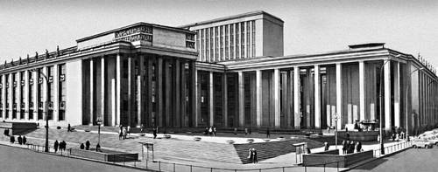
Real life example: bookshelf
Your bookshelf
Places for books
A-B | C-D | E-F | G-H | I-J | … | … | … | … | … | Y-Z
The first letter in the name of the author
fast
slow
Your table
City library

Slide 10
Why Does It Work?
Temporal Locality (Locality in Time):
If an item is accessed, it will tend to be accessed again soon
Example: code and variables in loops
→ Keep recently accessed data closer to the processor
Spatial Locality (Locality in Space):
If an item is accessed, nearby items tend to be accessed soon
Example: scanning an array
→ Move contiguous blocks closer to the processor
Locality + smaller HW is faster memory → hierarchy

Slide 11
Localities are usually contradicting
Read of a large data array (data size >> cache size) has spatial locality, but no temporal locality
Read of a single variable has temporal locality, but no spatial locality
for (size_t i = 0; i < N; ++i)
sum += a[i];
for (size_t i = 0; i < N; ++i)
sum += i + *a;

Slide 12
Cache implementation

Slide 13
Cache: Main Idea
The cache holds a small part of the entire memory
Need to map parts of the memory into the cache
Main memory is virtually partitioned into lines
Typical block size is 32 to 64 bytes
Blocks are aligned
The cache holds data by lines
Only a subset of the blocks is mapped to the cache at a given time
Address of lines is used as a key
Memory
#line
0
1
2
3
4
5
6
…
…
91
92
93
…
…
Cache
#line
2
91
4
5

Slide 14
Cache Lookup
Memory
Case 1: Cache Hit
The requested line is in the cache
The cache returns the requested line (fast)
Case 2: Cache Miss
line#
0
1
2
3
4
5
6
…
…
91
92
93
…
…
Cache
line#
2
91
5
hit
4
4?
CPU

Slide 15
Cache Lookup
Memory
Case 1: Cache Hit
The requested line is in the cache
The cache returns the requested line (fast)
Case 2: Cache Miss
The requested line is not in the cache
Need to fetch it from the main memory (slow) and fill the cache
May need to evict another line from the cache to free space for the new one
line#
0
1
2
3
4
5
6
…
…
91
92
93
…
…
Cache
line#
91
5
2
93
miss
93?
4
93?
CPU

Slide 16
Fully Associative Cache
Address
64 | 5 | 0
Tag = line# | Offset
Tag
Array
Data
Array
Line may be mapped to any cache entry
Lookup line in all entries
Address is partitioned to
Offset within a line (byte#)
Line # (so-called tag)
Each cache entry has a tag
All tags are compared to the line# in parallel
If one of the tags matches the line#, we have a hit
63
0
0
1
…
511
=
=
…
…
=
…
hit/miss
data

Slide 17
Direct Mapped Cache
Address
64 | 14 |  | 5 | 0
Tag | Set |  | Offset
Data
Array
Line is mapped to the fixed entry only
Lookup line in one entry
Address is partitioned to
Offset within a line (byte #)
Set (fixed cache entry #)
Tag (works as a key)
Conflicts are possible
If several lines are mapped to the same entry, only one can reside in the cache
Tag Array
set#
63
0
0
1
…
511
…
=
hit/miss
data

Slide 18
Memory Layout: Direct Mapped Cache
64
0
Memory Space
Memory is virtually partitioned
into lines
line size = 2 ^ offset_size
lines grouped into slices
# of lines in slices = 2 ^ set_size
slice size = # of lines in slice * line_size = cache size
slice # = tag value
line # inside a slice = set value
Disadvantage is line evictions due to set conflicts
 | Offset
 | Set | Offset
Tag | Set | Offset
set#
cache size
set#
cache size
tag#
Mapped to the same set
set#
cache size
…
set#
cache size

Slide 19
2-Way Set Associative Cache
Conflicts are harmful → multi-ways cache is a solution
Each set holds two entries (way 0 and way 1)
Each line can be mapped into one of two entries in the appropriate set
Address
64 | 13 |  | 5 | 0
Tag | Set |  | Offset
way #0
way #1
Tag Array
Data Array
Tag Array
Data Array
set#
63
0
set#
63
0
0
1
…
255
0
1
…
255

Slide 20
2-Way Set Associative Cache
Address
64 | 13 |  | 5 | 0
Tag | Set |  | Offset
Tag Array
Data Array
way #0
way #1
way #0
way #1
set#
set#
63
0
63
0
0
1
…
255
0
1
…
255
=
=
MUX
hit/miss
data

Slide 21
Memory Layout: Multi-Way Cache
Memory Space
set#
way size
Memory is virtually partitioned almost the same as in direct map cache
The only difference is slice size
slice size = cache size / # of ways
Compared to direct map cache
Decrease slice size → increase # of slices → increase # of lines mapped to the same set
But in each set we can have multiple lines (= # of ways) at a given time
Example: 32KB, 8 ways, 64B line
way size = 32KB / 8 = 4KB
# of sets = 4KB / 64B = 64
Mapped to the same set
…
address
64 | 11 |  | 5 | 0
Tag | Set |  | Offset

Slide 22
Memory Layout: Multi-Way Cache
Slice is Nx smaller
For fully-associative cache N is equal to cache size in lines
For direct mapped cache N == 1
Address partitioning formulas:
set #
slice
Mapped to N cache lines
63 | Y |  | X | 0
Tag | Set |  | Offset
…
X = log(block_size)
Y = log(cache_size / N)

Slide 23
Performance metrics

Slide 24
Cache Performance
Terms:
Miss Rate = Misses / total CPU request
Hit Rate = Hits / total CPU request = 1 – Miss Rate
Cache goal is decreasing average memory access time (AMAT)
AMAT = Hit Rate * Hit Time + Miss Rate * Miss Penalty
AMAT ≈ Hit Time + Miss Rate * Miss Penalty
Example:
HitRate ≈ 0.9, HitTime ≈ 4 clk, MissRate ≈ 0.1, MissPenalty ≈ 200 clk, then…
AMAT = 0.9 * 4 + 0.1 * 200 = 23.6 clk
AMAT w/o cache = 200 clk
About 10x improve!

Slide 25
Motivation for multi-level caches
L1 cache: AMAT ≈ HitTimeL1 + MissRateL1 * MissPenaltyL1
L2 reduces L1 miss penalty – saves access to memory
Now, on L1 miss we access L2, but not memory
MissPenaltyL1 ≈ HitTimeL2 + MissRateL2 * MissPenaltyL2
L2 Cache is larger (better HitRate), but has higher latency
Example:

Slide 26
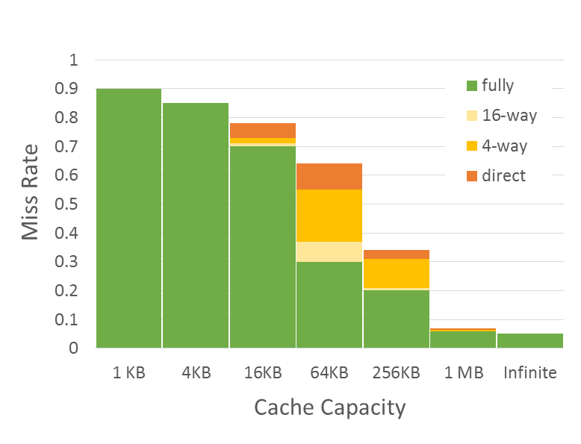
Three Types of Cache Misses (3-C)
Miss Rate = F(Cache Capacity, Associativity)
Conflict
Compulsory misses
Those that occurs even in a infinite cache
First access to data
So-called cold misses
Capacity misses
Those that occurs in an fully associative cache
Workset is larger than the cache size
Conflict misses
Difference between fully associate and direct mapped cache
The size of the cache is enough, but the problem is in line mapping to sets
Compulsory
Capacity

Slide 27
Software Optimizations

Slide 28
Loop Fusion
Combine loops that have same looping and work with the same memory
Assume each element is 8 bytes, 32KB cache, 64 B/line
for (i = 0; i < 10240; i++)
a[i] = 1 / a[i];
…
for (i = 0; i < 10240; i++)
sum = sum + a[i];
Fuse the loops
for (i = 0; i < 10240; i++) {
a[i] = 1 / a[i];
sum = sum + a[i];
}
Improves temporal locality

Slide 29
Loop Interchange
Change loops nesting to access data in order stored in memory
Two dimensional array in memory:
x[0][0] x[0][1] … x[0][99] x[1][0] x[1][1] …
Before:
for (j = 0; j < 100; j++)
for (i = 0; i < 5000; i++)
x[i][j] = 2 * x[i][j];
Improves spatial locality
Sequential accesses instead of striding through memory every 100 words
After:
for (j = 0; j < 100; j++)
for (i = 0; i < 5000; i++)
for (j = 0; j < 100; j++)
x[i][j] = 2 * x[i][j];
for (i = 0; i < 5000; i++)
x[i][j] = 2 * x[i][j];

Slide 30
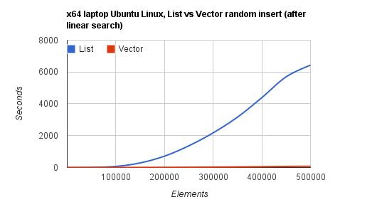
“Stop using linked lists”
Linked lists have no spatial locality
→ cache handles them worse than arrays
→ O(N) operation with array is much faster than O(N) operation with list
Example: random insert after linear search
https://kjellkod.wordpress.com/2012/02/25/why-you-should-never-ever-ever-use-linked-list-in-your-code-again

Slide 31
AoS vs SoA
Array of structures (AoS)
Structure of arrays (SoA)
struct map {
int val;
int key;
// ...
} merged_array[SIZE];
Locality if value and key are used together
Worse utilization otherwise
struct map {
int val[SIZE];
int key[SIZE];
// ...
} merged_struct;
Locality if value and key are used independently
Possible inter-set conflicts between values

Slide 32
Data alignment
Example: cache line size is 64 bytes, we load 4 bytes by address 0x3c
How many cache lines has to be looked up?
What if the first is hit and the second is miss?
Preferable solution: align memory access in a cache line
Required by many ISA, e.g. MIPS, RISC-V, x86 vector extensions
Basic sizeof(long double) alignment guaranteed by C
Alternative solution: add HW to make two accesses
Handles legacy cases and has worse performance (Amhdal’s law)

Slide 33
Agenda, part 2
Memory Wall
Spatial and temporal locality
Hardware implementations
Performance metrics
Software optimizations
Hardware optimizations
Prefetching
Replacement
Write handling
Multi-level cache organization
Modeling in simulator

Slide 34
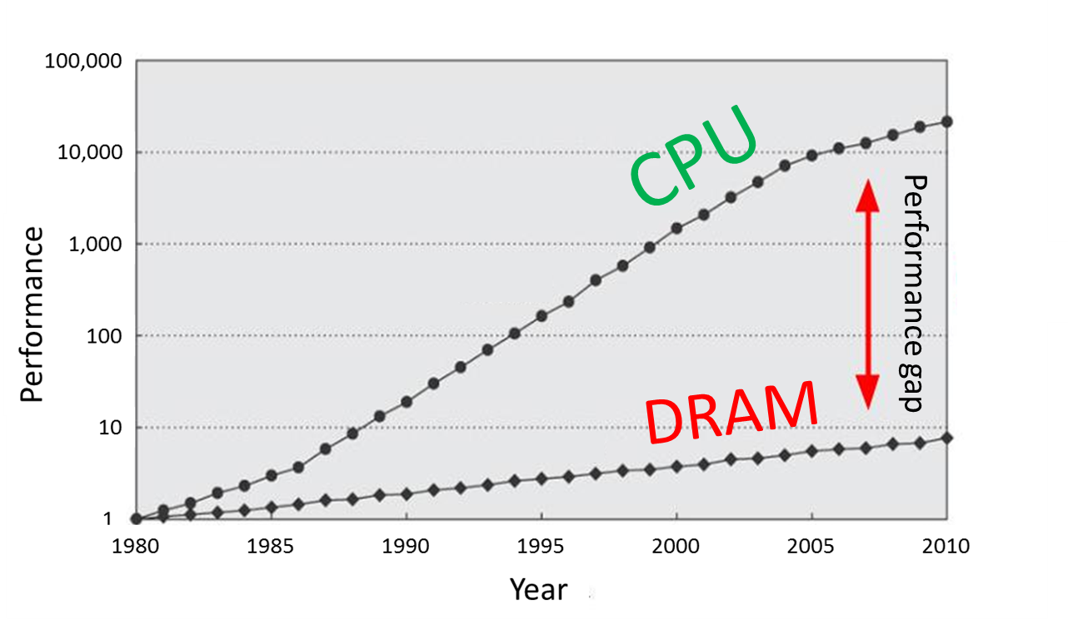
Refresher
Main memory is large, but slow
Solution: memory hierarchy with caches
utilizes temporal and spatial locality of workloads
provides visibility that memory is usually fast
Bad scenario: cache misses
Compulsory
Capacity
Conflict
L3
Cache
Main Memory
L1
L2
CPU
smallest, but fastest
slowest, but largest

Slide 35
Prefetching

Slide 36
Prefetching: main idea
Prefetching – predict future memory accesses
A useful prefetch eliminates a potential cache miss
2 types of prefetching:
Software Prefetching: special prefetching instructions
Hardware Prefetching
Code prefetching is performed by a branch predictor
Prefetch Limitations
Prefetching relies on extra memory bandwidth
Too aggressive/inaccurate prefetching slows down demand fetches

Slide 37
Quality metrics
Accuracy
Portion of prefetched lines which eventually become demand-hits
Coverage
Portion of cache misses removed by prefetching
Timeliness
Reduction of cache miss time
For L1 cache prefetch schemes with high accuracy are used
Bigger caches usually leverage schemes with higher coverage

Slide 38
Next sequential
On a cache miss, prefetch sequential cache line (± 64 bytes)
Prefetch metrics:
Moderate accuracy
Low coverage
Lack of timeliness (prefetch performed too late)
Simple HW
Works well for instructions prefetch
“Fallback" if more complex methods not available
lw $t0, 0x0($t1)
prefetch 0x40($t1)

Slide 39
Stride detection
HW detects the repetitive step of a load and prefetch data in advance
Prefetch metrics:
High accuracy (for long loops)
Low coverage
Highly timeliness
Issues with unrolled loops
Initially single load operation occupies multiple entries in detector
Detector
0x00402f0: lw $t0, 0x20($t1)
0x00402f4: add $t2, $t2, $t0
0x00402f8: addi $t1, $t1, 0x100
0x00402fc: beq $t1, $t3, -4
IP | Stride | Last address
0x00402f0 | 0x100 | 0x00f4180
prefetch 0x00f4280
prefetch 0x00f4380
...

Slide 40
Stream detection (1)
HW detects stream with the repetitive step
Similar to the previous technique, but without reference to IP
Example:
0xba20200
0x3cf1140 0xba203с0
0x3cf1100
0x3cf10c0
0x3cf1080
0xba20740
0xba20900
...
0xba20200
0x3cf1140 0xba203с0
0x3cf1100
0x3cf10c0
0x3cf1080
0xba20740
0xba20900
...
Base address | Stride | Last address
0xba20200 | +0x1c0 | 0xba20900
0x3cf1140 | −0x40 | 0x3cf1080
prefetch 0xba20ac0
prefetch 0x3cf1040
...

Slide 41
Stream detection (2)
Stream detection without repetitive step
load pattern not found, only direction – load everything following this direction
Prefetch metrics:
Low accuracy
High coverage
Highly timeliness
0xba20200 0xba20340
0xba203a0
0xba204с0
0xba20520
...
Base address | Stride | Last address
0xba20200 | +????
prefetch 0xba20560
prefetch 0xba205a0
...

Slide 42
Replacement

Slide 43
Cache Line Replacement
When miss occurs need to free space in a cache for a new line
Direct mapped cache
A new line is mapped to a single entry → evict old line from the entry
N-way set associative cache
Choose a victim from all ways in the appropriate set, but how?
FIFO (First In First Out) replacement
Easy to implement in HW, but can violate temporal locality
LRU (Least Recently Used) replacement
Evict the most unused line (was not accessed longer than other)
Good temporal locality, but complex HW → use simplified pseudo-LRU

Slide 44
Pseudo-LRU
Pseudo-LRU is a good approximation of LRU with a binary tree
Each node stores information about which of the descendants was recently used
Request «B»
Request «A»
Request «E»
L
R
R
L
R
L
L
L
R
L
R
R
A
B
C
D
A
B
C
D
A
B
C
D
A
B
E
D

Slide 45
Counterexample
Sometimes there is no temporal locality
Example: read of large data array (data size >> cache size)
In case of LRU the second loop will always ‘miss’
If data eviction follows MRU policy (most-recently used) the second loop will start with ‘hit’
for (size_t i = 0; i < N; ++i)
sum += a[i];
double average = sum / N; for (size_t i = 0; i < N; ++i)
a[i] -= average;

Slide 46
Write handling

Slide 47
Cache write policies
Memory writes (store instructions) also need to update a cache
WriteThrough: always update both memory and cache
+ Coherence: cache and memory are always in the same state
- Higher utilization of memory bandwidth
WriteBack: update only cache, update memory at line eviction
+ Low store latency and memory bandwidth
- Risk of data loss, requires snoops – coherency checks

Slide 48
Multi-level cache organization

Slide 49
Motivation for multi-level caches
Only L1 cache: a large miss penalty due to memory access
With L2 cache: L1 miss penalty is reduced
Now, on L1 miss we access L2, not memory
L2 Cache is larger (lower MissRate), but has higher latency
Example:
L2
Main Memory
CPU
L1
<T> ≈ T_L1hit + MissRateL1 * T_mem
<T> ≈ T_L1hit + MissRateL1 * (T_L2hit + MissRateL2 * T_mem)
<T> ≈ 3 + 0.08 * 200 = 19 clk
x5 !
<T> ≈ 3 + 0.08 * (6 + 0.03 * 200) = 3.96 clk

Slide 50
Multi-level inclusion policies
1. Inclusive
2. Exclusive
3. Non-Inclusive/Non-Exclusive (NINE)
M/NM
L1
modified only
M/NM
L1
L1
modified only
L2
L2
L2
modified only
modified only
+ low bandwidth
- lines duplications
+ effective cache usage
- higher bandwidth
combination of 2 policies

